Slide 1
Psychology: From Inquiry to Understanding
Fourth Edition
Chapter 6
Learning
HOW NURTURE CHANGES US

Slide 2
Learning LO 6.1a Describe Pavlov’s model of classical conditioning and discriminate conditioned stimuli and responses from unconditioned stimuli and responses.
Relatively permanent change in an organism’s behavior or thought as a result of experience

Slide 3
Classical Conditioning LO 6.1a Describe Pavlov’s model of classical conditioning and discriminate conditioned stimuli and responses from unconditioned stimuli and responses.
Large amounts of learning occur though association.
The British Associationists believed we acquired most knowledge via conditioning.
Simple associations provided the mental building blocks for more complex ideas.

Slide 4
Pavlov’s Discovery of Classical Conditioning (1 of 4) LO 6.1a Describe Pavlov’s model of classical conditioning and discriminate conditioned stimuli and responses from unconditioned stimuli and responses.
Russian physiologist and 1904 Nobel Prize winner
Most famous for work on digestion of the dog
This included the first work on classical conditioning.

Slide 5
Pavlov’s Discovery of Classical Conditioning (2 of 4) LO 6.1a Describe Pavlov’s model of classical conditioning and discriminate conditioned stimuli and responses from unconditioned stimuli and responses.
Involves five primary components:
Neutral stimulus (NS)
Unconditioned stimulus (UCS)
Unconditioned response (UCR)
Conditioned stimulus (CS)
Conditioned response (CR)

Slide 6
Pavlov’s Discovery of Classical Conditioning (3 of 4) LO 6.1a Describe Pavlov’s model of classical conditioning and discriminate conditioned stimuli and responses from unconditioned stimuli and responses.
Start with a neutral stimulus (NS), which does not elicit a particular response.
Example: the sound of a Metronome
Pair the NS close in time and repeatedly with the unconditioned stimulus (UCS—meat powder); the meat powder naturally elicits an unconditioned response (UCR—salivation).
Notes:
LO 6.1

Slide 7
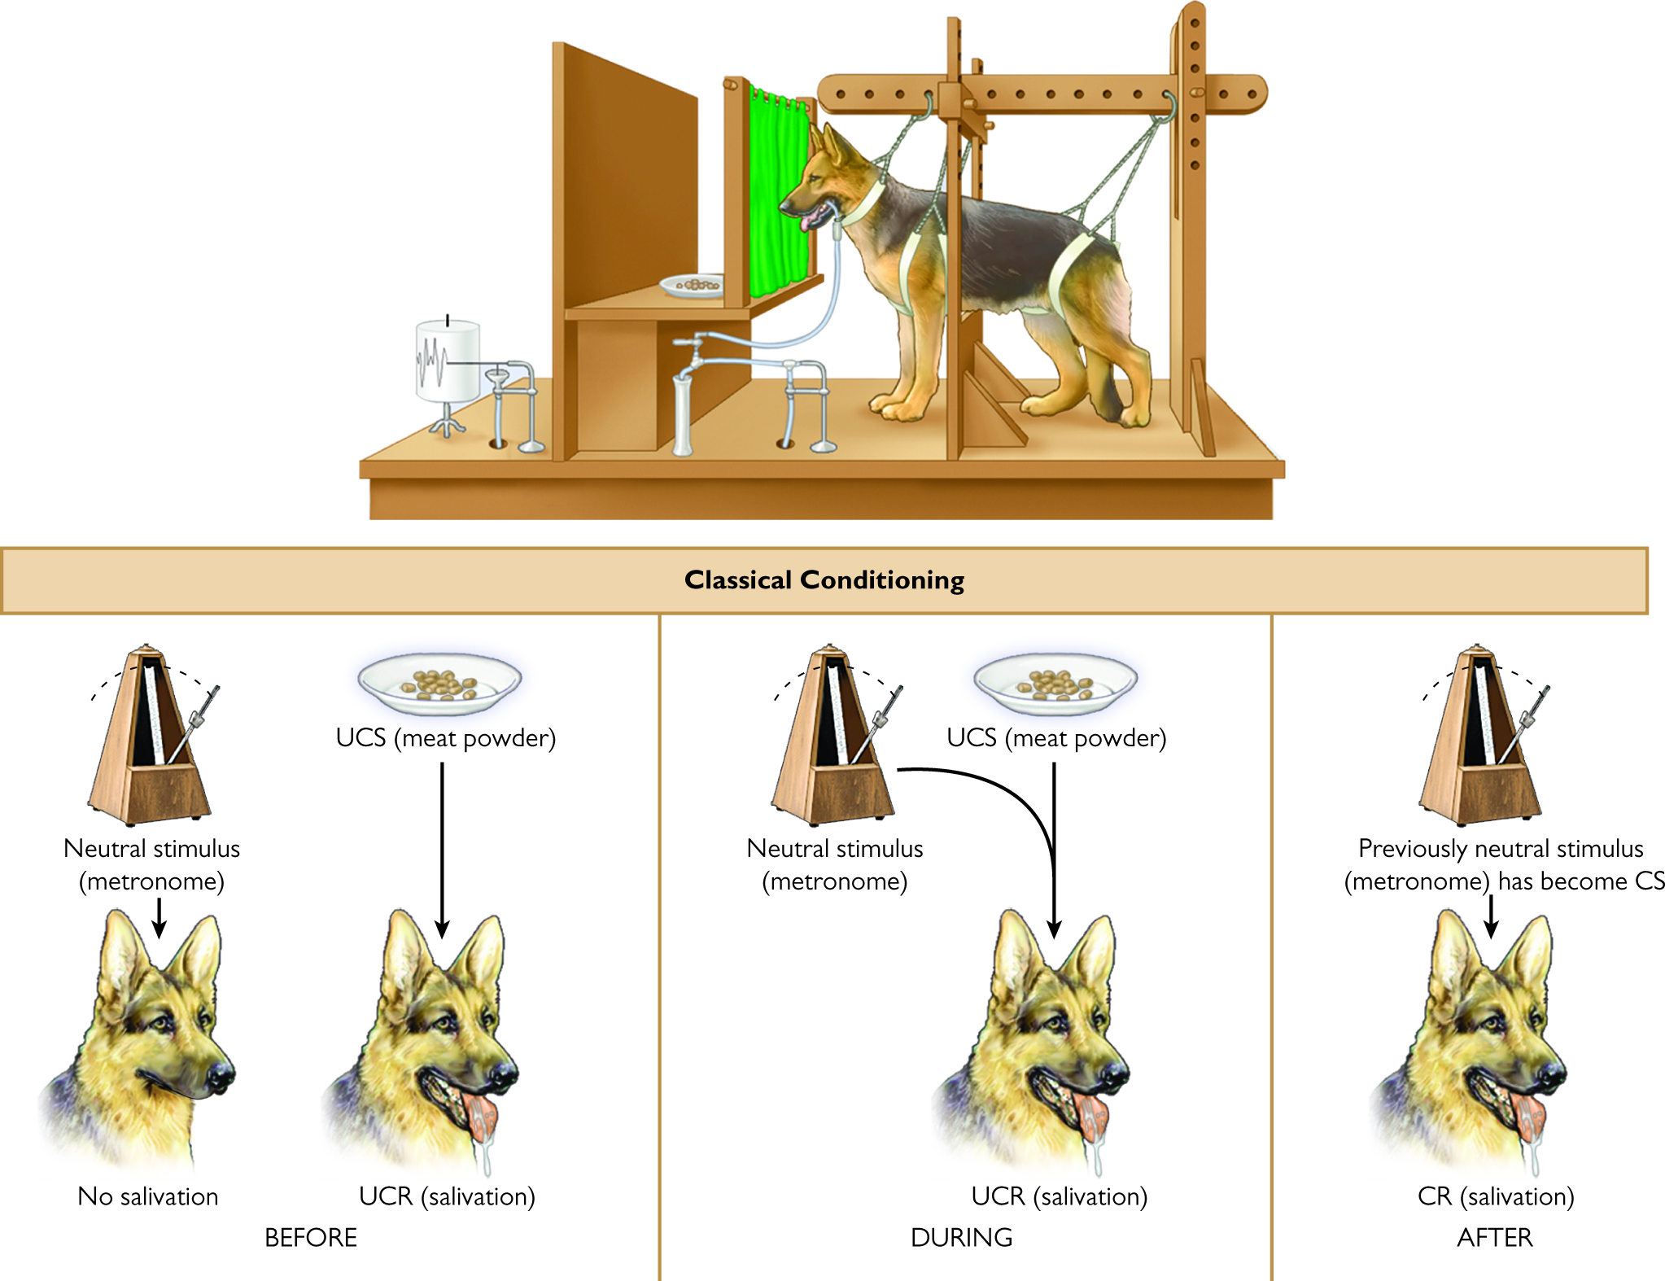
Figure 6.2 Pavlov’s Classical Conditioning Model

Slide 8
Pavlov’s Discovery of Classical Conditioning (4 of 4) LO 6.1a Describe Pavlov’s model of classical conditioning and discriminate conditioned stimuli and responses from unconditioned stimuli and responses.
With repeated pairings, the NS becomes a conditioned stimulus (CS), eliciting a conditioned response (CR).
Metronome and salivation
The organism reacts the same way to the CS as it did to the UCS.
Notes:
LO 6.1

Slide 9
Principles of Classical Conditioning (1 of 2) LO 6.1b Explain the major principles and terminology associated with classical conditioning.
Acquisition is the phase during which a CR is established.
Extinction is the reduction and elimination of the CR after the CS is presented repeatedly without the UCS.
Notes:
LO 6.1

Slide 10
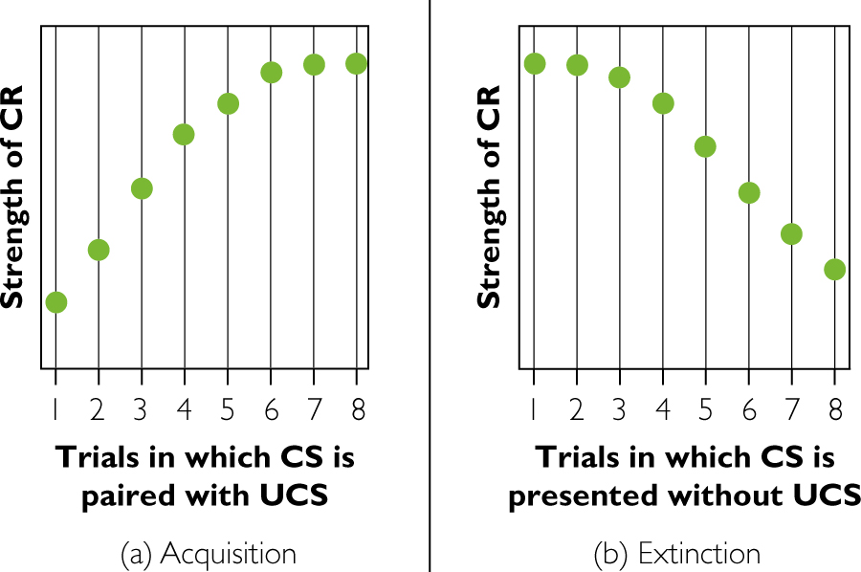
Figure 6.3 Acquisition and Extinction

Slide 11
Principles of Classical Conditioning (2 of 2) LO 6.1b Explain the major principles and terminology associated with classical conditioning.
Stimulus generalization occurs when similar CSs elicit the same CR.
Driving a new car
Stimulus discrimination occurs when one exhibits a particular CR only to certain stimuli, but not to similar others.
Movie about tornado vs. tornado in real life
Notes:
LO 6.1

Slide 12
Operant/Instrumental Conditioning LO 6.2a Distinguish operant conditioning from classical conditioning.
Learning controlled by the consequences of the organism’s behavior
The organism gets something because of its response.
Also known as instrumental conditioning

Slide 13
Table 6.2 Distinguishing Operant Conditioning from Classical Conditioning LO 6.2a Distinguish operant conditioning from classical conditioning.
 | Classical Conditioning | Operant Conditioning
Target behavior is … | Elicited automatically | Emitted voluntarily
Reinforcement is … | Provided unconditionally | Contingent on behavior
Behavior depends primarily on … | Autonomic nervous system | Skeletal muscles
Notes:
LO 6.2

Slide 14
The Law of Effect (1 of 2) LO 6.2b Describe Thorndike’s law of effect.
If we’re reinforced for a response, we’re more likely to repeat that response in the future.
Learning involves an association between a response and a stimulus, with the reinforcing stimulus “stamping in” this connection.
Notes:
LO 6.3

Slide 15
The Law of Effect (2 of 2) LO 6.2b Describe Thorndike’s law of effect.
Psychologist E. L. Thorndike formulated the law of effect after experimenting with cats in puzzle boxes.
Thorndike found no insight in cats. Instead they learned through trial and error.

Slide 16
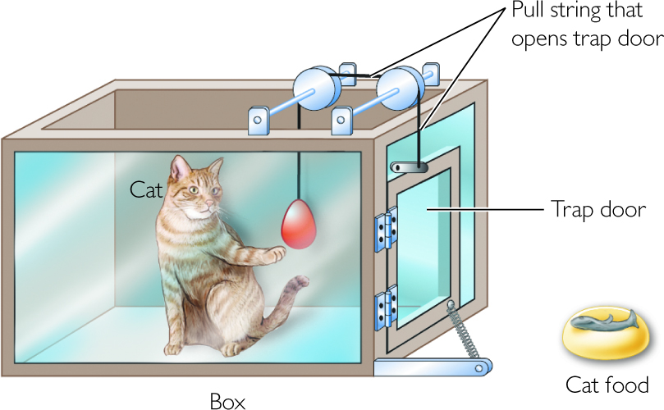
Figure 6.5 Thorndike’s Puzzle Box

Slide 17
B. F. Skinner and Reinforcement LO 6.2c Describe reinforcement and its effects on behavior and distinguish negative reinforcement from punishment.
Followed up on Thorndike’s work on the law of effect
Designed the Skinner box (or operant chamber) to record organisms’ activities more effectively
Notes:
LO 6.3

Slide 18
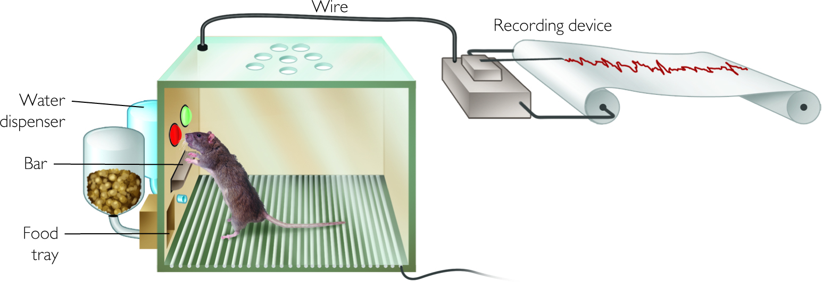
Figure 6.7 Rat in Skinner Box and Electronic Device for Recording the Rat’s Behavior

Slide 19
Terminology of Operant Conditioning (1 of 5) LO 6.2c Describe reinforcement and its effects on behavior and distinguish negative reinforcement from punishment.
Reinforcements are outcomes that increase the probability of a response.
Positive reinforcement involves giving a stimulus.
Negative reinforcement involves taking away a stimulus.
Notes:
LO 6.3

Slide 20
Terminology of Operant Conditioning (2 of 5) LO 6.2c Describe reinforcement and its effects on behavior and distinguish negative reinforcement from punishment.
Punishment is any outcome that decreases the probability of a response.
Like reinforcement, it can be positive or negative.
Disciplinary actions are punishments only if they decrease the chance of the behavior happening again.
Notes:
LO 6.4

Slide 21
Table 6.3 Terminology of Operant Conditioning (3 of 5) LO 6.2c Describe reinforcement and its effects on behavior and distinguish negative reinforcement from punishment.
 | Procedure | Effect on behavior | Typical Example
Positive Reinforcement | Presenting a stimulus | Increases target behavior | Giving a gold star on homework, resulting in a student studying more
Negative Reinforcement | Removing a stimulus | Increases target behavior | Static on phone subsides when you stand in a specific spot in your room, causing you to stand there more often to decrease the static
Positive Punishment | Presenting a stimulus | Decreases target behavior | Scolding by a pet owner, reducing a dog’s habit of chewing on shoes
Negative Punishment | Removing a stimulus | Decreases target behavior | Taking away a favorite toy, stopping a child from throwing future tantrums

Slide 22
Terminology of Operant Conditioning (4 of 5) LO 6.2c Describe reinforcement and its effects on behavior and distinguish negative reinforcement from punishment.
Behaviorists argue that punishment is much less effective than reinforcement in modifying human behavior.
Punishment has several disadvantages
Only tells what not to do
Creates anxiety
Encourages subversive behavior
May provide model for aggressive behavior
Notes:
LO 6.5

Slide 23
Schedules of Reinforcement (1 of 3) LO 6.2d Identify the four schedules of reinforcement and the response pattern associated with each.
Refers to the pattern of delivering reinforcements
Continuous reinforcement is typically used to establish a new behavior.
Partial reinforcement occurs when we reinforce responses only some of the time.
More resistant to extinction

Slide 24
Schedules of Reinforcement (2 of 3) LO 6.2d Identify the four schedules of reinforcement and the response pattern associated with each.
Vary along two dimensions
Consistency of administering reinforcement
Fixed or variable
The basis of administering reinforcement
Ratio or interval
Notes:
LO 6.6

Slide 25
Schedules of Reinforcement (3 of 3) LO 6.2d Identify the four schedules of reinforcement and the response pattern associated with each.
Fixed ratio—reinforcement after a set number of responses
Variable ratio—reinforcement after specific number of responses, on average
Fixed interval—reinforcement after specific amount of time
Variable interval—reinforcement after an average time interval

Slide 26
Applications of Operant Conditioning to Daily Life (2 of 2) LO 6.2e Describe some applications of operant conditioning.
Training using shaping
Using token economies in clinical settings to shape desired behaviors
Primary and secondary reinforcers

Slide 27
6.3: Cognitive Models of Learning
6.3a Outline the evidence that supports latent learning and observational learning.
6.3b Identify evidence of insight learning.

Slide 28
Cognitive Models of Learning LO 6.3a Outline the evidence that supports latent learning and observational learning.
Early behaviorists did not believe that thinking played a significant role in learning.
Argued that thinking and emotions are just covert behaviors
Today, psychologists acknowledge at least some role for cognitions.
Notes:
LO 6.6

Slide 29
Latent Learning (1 of 2) LO 6.3a Outline the evidence that supports latent learning and observational learning.
Refers to learning that is not directly observable
Competence vs. performance
Implies that reinforcement is not necessary for learning to occur
Tolman & Honzik’s maze trials
Notes:
LO 6.7

Slide 30
Latent Learning (2 of 2) LO 6.3a Outline the evidence that supports latent learning and observational learning.
The rats had developed cognitive maps that were only used once there was a reinforcer.
This research challenged radical behaviorism and implied that thinking plays a role in some forms of learning.
Notes:
LO 6.7

Slide 31
Observational Learning (1 of 2) LO 6.3a Outline the evidence that supports latent learning and observational learning.
Means learning by watching others
Don’t have to engage in trial and error to learn how to do something new
Bandura’s research on observing aggression: The Bobo Doll experiments
Notes:
LO 6.7

Slide 32
Observational Learning (2 of 2) LO 6.3a Outline the evidence that supports latent learning and observational learning.
Media violence and real-world aggression
Many types of research have examined the impact of violent media on behavior.
Results suggest that media violence impacts real-world aggression in some cases.
But, media violence is only one small contributor to real-world aggression.
Notes:
LO 6.8

Slide 33
Mirror Neurons and Observational Learning LO 6.3a Outline the evidence that supports latent learning and observational learning.
Prefrontal neurons that become active when an animal observes or performs an action
May play a role in observational learning and having empathy for others
Notes:
LO 6.8

Slide 34
6.4: Biological Influences on Learning
6.4a Explain how biological predispositions can facilitate learning of some associations.

Slide 35
Conditioned Taste Aversions LO 6.4a Explain how biological predispositions can facilitate learning of some associations.
Conditioned taste aversions
Develop after only one trial
Can have very long delays (6–8 hours)
Show little generalization
Notes:
LO 6.9

Slide 36
Preparedness and Phobias LO 6.4a Explain how biological predispositions can facilitate learning of some associations.
Preparedness for certain phobias
We are evolutionarily predisposed to be more afraid of certain things than of others.
Snakes and spiders vs. cars and guns
Notes:
LO 6.9

Slide 37
Instinctive Drift LO 6.4a Explain how biological predispositions can facilitate learning of some associations
The tendency for animals to return to innate behaviors following repeated reinforcement is called instinctive drift.
Biological influences place limits on what kinds of behaviors we can train through reinforcement.
Keller and Marion Breland and the IQ Zoo
Notes:
LO 6.9

